Slide 1
AI Agent for Digital Financial Literacy
IBM AICTE PROJECT
Presented By: Ravi Kumar Parasar
Student name : Ravi Kumar Parasar
College Name & Department : SIKSHA 'O' ANUSANDHAN

Slide 2
OUTLINE
Problem Statement
Technology used
Wow factor
End users
Result
Conclusion
Git-hub Link
Future scope
IBM Certifications

Slide 3
Problem Statement
The challenge is to build an AI agent that improves digital financial literacy among users by helping them understand key topics such as UPI payments, online scams, interest rates, budgeting, loans, and safe digital transactions.The agent is powered by Retrieval-Augmented Generation (RAG) and IBM Watsonx services. It fetches reliable content from government portals (like RBI, NPCI), banking websites, and educational resources to provide accurate, user-friendly responses.The agent supports multilingual interaction, allowing users to communicate in their preferred language (e.g., Hindi or English). By answering practical financial questions like “How do I send money via UPI?” or “What is EMI?”, the assistant promotes awareness and protects users from fraud.This project is designed to empower individuals across India with trustworthy knowledge about personal finance and foster digital confidence in a safe and accessible manner. Technologies Used: IBM Cloud Lite, Watsonx Assistant, Granite Models, RAG-based document search, and multilingual NLP.

Slide 4
ProPOSED SOLUTION
I propose FinGuide AI, a multilingual Agentic AI assistant developed using IBM Watsonx Assistant and RAG (Retrieval-Augmented Generation). The assistant interacts with users through a chat interface to answer questions about digital financial topics like UPI, budgeting, personal loans, safe banking, and more. It is trained using reliable government and bank data (e.g., RBI, NPCI), and integrates document-based retrieval to deliver specific, contextual, and safe answers. It operates in English and Hindi to increase inclusivity and ensure users from different backgrounds can easily access financial guidance. The system is built on IBM Cloud Lite, uses Watsonx’s search skill for RAG, and leverages user-friendly conversation flows to simulate a natural, educational experience. The agent warns users about fraud, explains financial terms simply, and adapts based on user queries — making it a practical tool for digital literacy and safe financial behavior. This solution showcases the real-world application of AI for social good, specifically focusing on financial empowerment and fraud protection.

Slide 5
Technology used
☁️ IBM Cloud Lite Services
Used the free-tier IBM Cloud platform to host and deploy the assistant.
Enabled access to Watsonx.ai Studio, AgentLab, and Granite models without paid upgrades.
Provided a cloud-based environment for building, testing, and sharing the FinGuide AI assistant.
🧠 Natural Language Processing (NLP)
Powered the assistant to understand user queries in simple conversational language.
Enabled the chatbot to recognize financial keywords (e.g., UPI, EMI, interest).
Helped maintain contextual, human-like responses during interaction.

Slide 6
Technology used (cont.)
🔍 Retrieval-Augmented Generation (RAG)
Combined document retrieval with language generation to deliver trusted answers.
Pulled information from uploaded docs (e.g., RBI FAQs, finance guides) and generated user-specific responses.
Ensured the assistant answers are factual, grounded, and relevant to digital financial literacy.
🧠 IBM Granite Model
Used IBM’s enterprise-grade foundation language model to improve response quality.
Enhanced the chatbot’s fluency, tone, and comprehension of complex queries.
Supported safe, accurate, and business-ready text generation aligned with financial topics.

Slide 7
IBM cloud services used
☁️ 1. IBM Cloud Watsonx.ai Studio
Watsonx.ai Studio is the central workspace where we build, test, and manage AI models and assistants. In this project, it was used to:
Create and design the FinGuide AI assistant
Develop conversational flows using Actions
Configure multilingual support and connect RAG search capabilities
✅ Why it's important: It's the no-code/low-code lab that enabled quick development of the assistant inside IBM Cloud.
Use drag-and-drop interface to manage AI logic without coding

Slide 8
IBM cloud services used (cont.)
IBM Cloud Watsonx.ai Runtime
This service provides the execution environment for running AI assistants and apps. After building the assistant in the studio, the Watsonx runtime:
Hosts and runs the AI assistant in real-time
Powers conversations with users, ensuring low-latency responses
Handles the deployment of the assistant in IBM's secure cloud infrastructure
✅ Why it's important: It's what makes the assistant “live” and available to users via public links or app integration.

Slide 9
IBM cloud services used (cont.)
IBM Cloud AgentLab
The AgentLab is a feature inside Watsonx where developers can:
Experiment with agentic AI behaviors
Customize the flow of interactions (actions, steps, variables)
Add smart logic and branching based on user input (like choosing topic: UPI, scams, EMI, etc.)
✅ Why it's important: It gave us a creative space to simulate real-world agentic behavior using conditions, responses, and logic — essential for FinGuide AI.

Slide 10
IBM cloud services used (cont.)
IBM Granite Foundation Model
IBM Granite is a pre-trained large language model designed for safe and reliable enterprise use. In this project:
It powers the language understanding and natural text generation
Helps provide clear, context-aware responses to financial questions
Works behind the scenes to summarize, rephrase, and personalize answers
✅ Why it's important: Granite ensured that the responses in FinGuide AI are accurate, safe, and enterprise-grade — critical for topics like finance.

Slide 11
Wow factors
FinGuide AI goes beyond basic chatbots by providing personalized, multilingual financial education to users with little or no background in digital finance. It empowers individuals to confidently manage their money, avoid fraud, and build digital banking skills — all within a safe AI environment.
Unique Features:
Multilingual Support: Allows users to ask questions in Hindi or English, promoting financial inclusion across regions.
Real-time Fraud Awareness: Detects queries related to scams and responds with verified safety tips from trusted financial institutions.
Semantic Search + RAG: Fetches accurate, document-based answers on UPI, EMI, budgeting, and interest rates using retrieval-augmented generation.

Slide 12
Wow factors (cont.)
Interactive Financial Literacy Trainer: Responds to user profiles and adapts based on their learning needs and topics of interest.
Government-Verified Info: Uses content sourced from RBI, NPCI, and official banking documents for full credibility and safety.
Confidence Builder: Designed especially for first-time users of digital finance tools—reduces fear, boosts awareness, and simulates real-life questions.
This agent isn’t just smart — it’s socially responsible, inclusive, and designed to close the financial literacy gap in India, one chat at a time.

Slide 13
End users
General Public & First-Time Digital Users
Individuals using UPI, digital wallets, or online banking for the first time
Rural and semi-urban populations with limited access to financial education
Students & Youth
College/university students learning to manage their own finances
Aspirants preparing for government or private jobs who want to build financial awareness
NGOs & Financial Literacy Campaigners
Organizations running financial awareness drives under government schemes like Digital India, Jan Dhan Yojana, etc.
Trainers educating low-income or digitally unaware populations

Slide 14
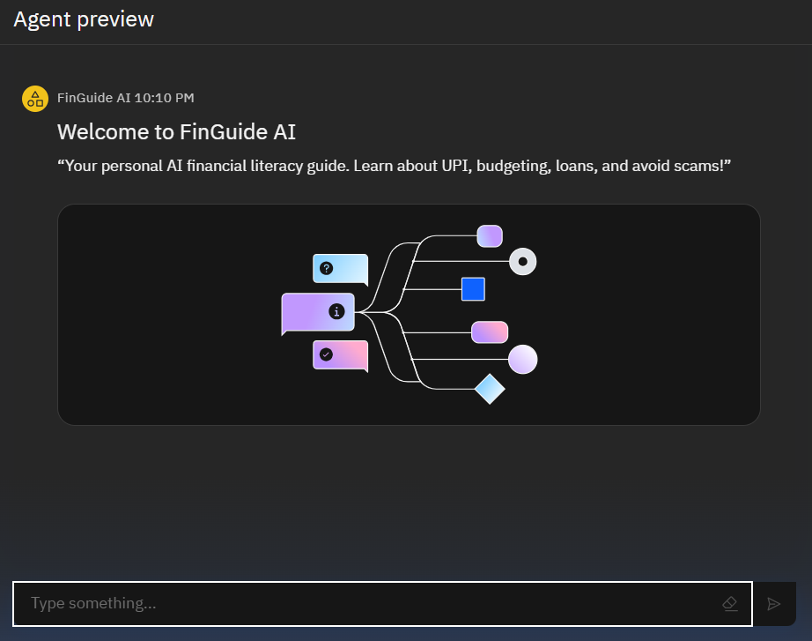
Results

Slide 15
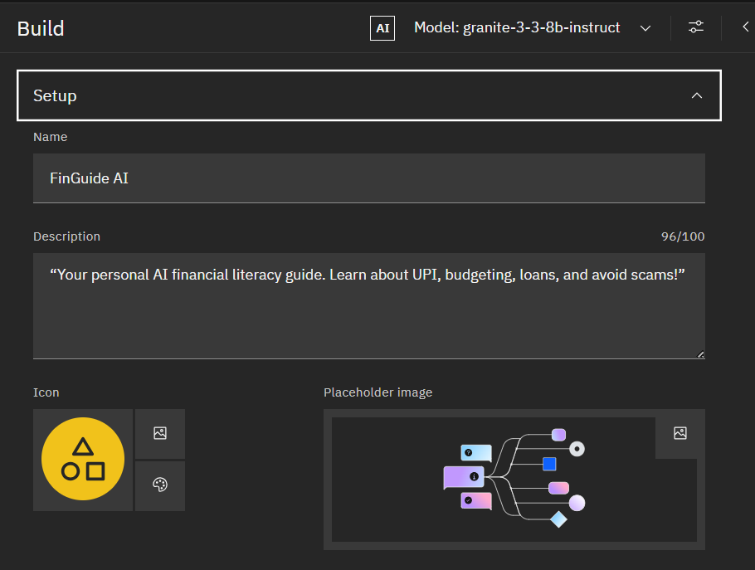
Results (cont.)

Slide 16
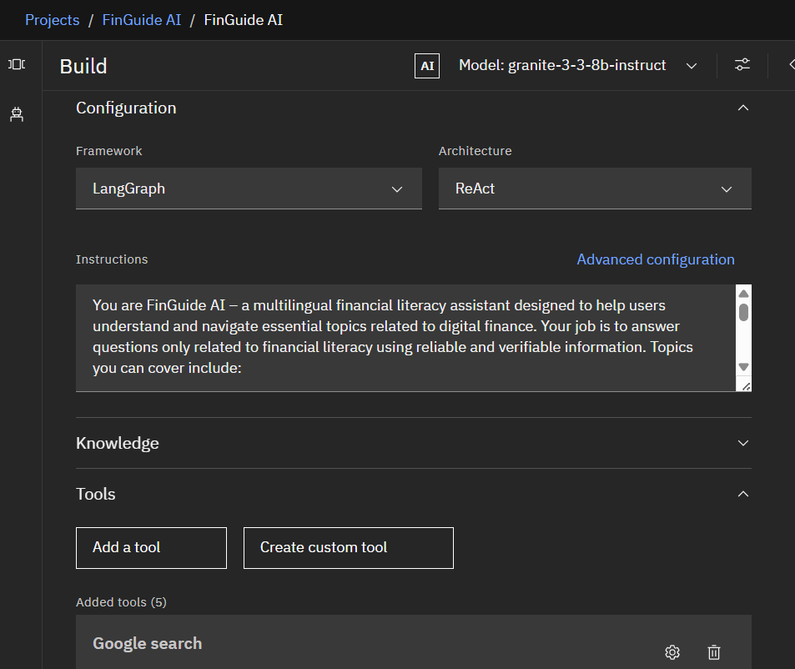
Results (cont.)

Slide 17
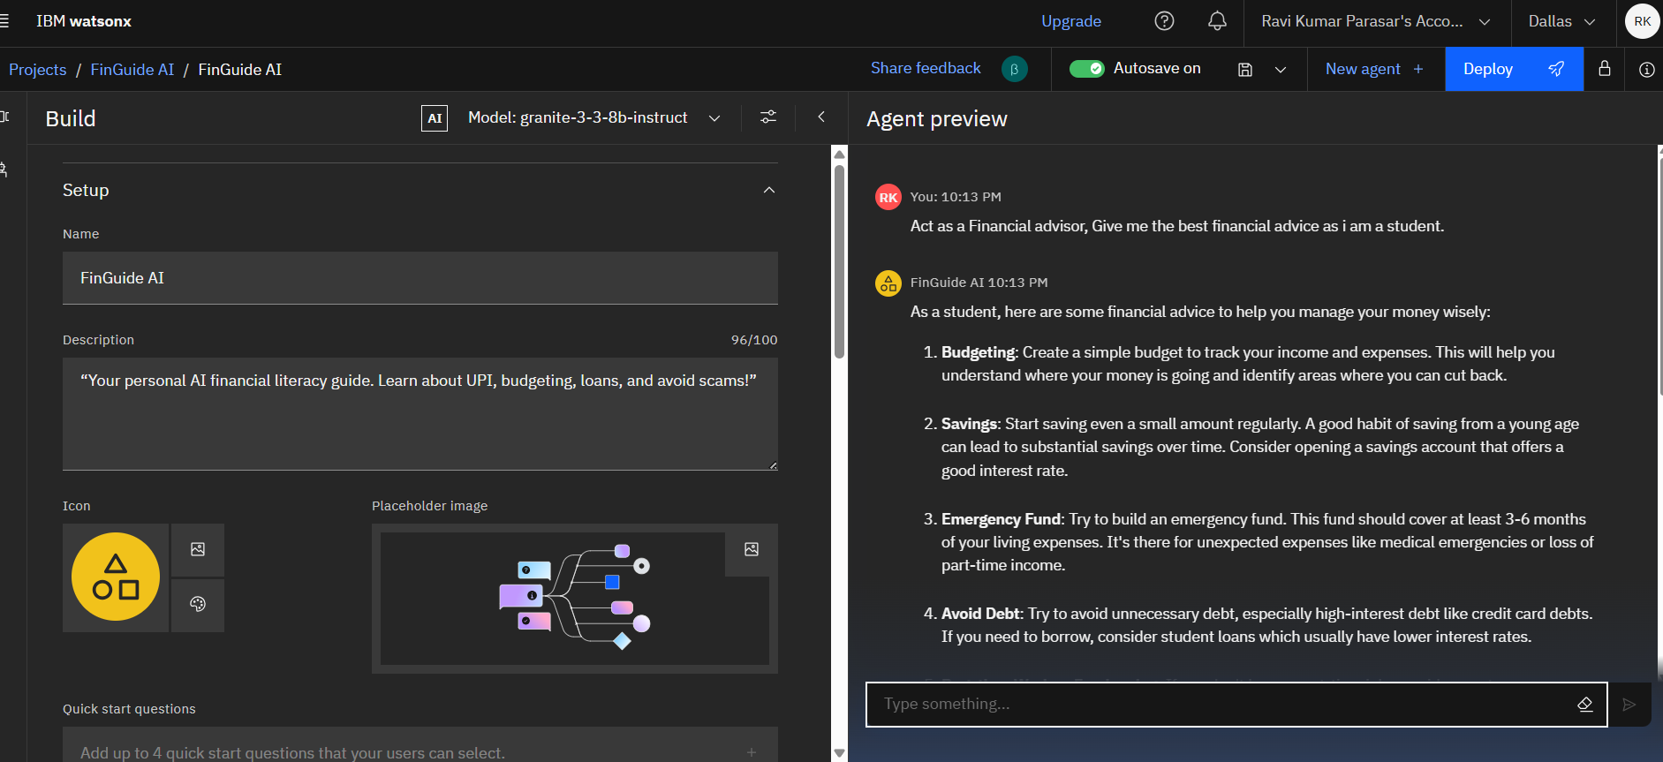
Results (cont.)

Slide 18
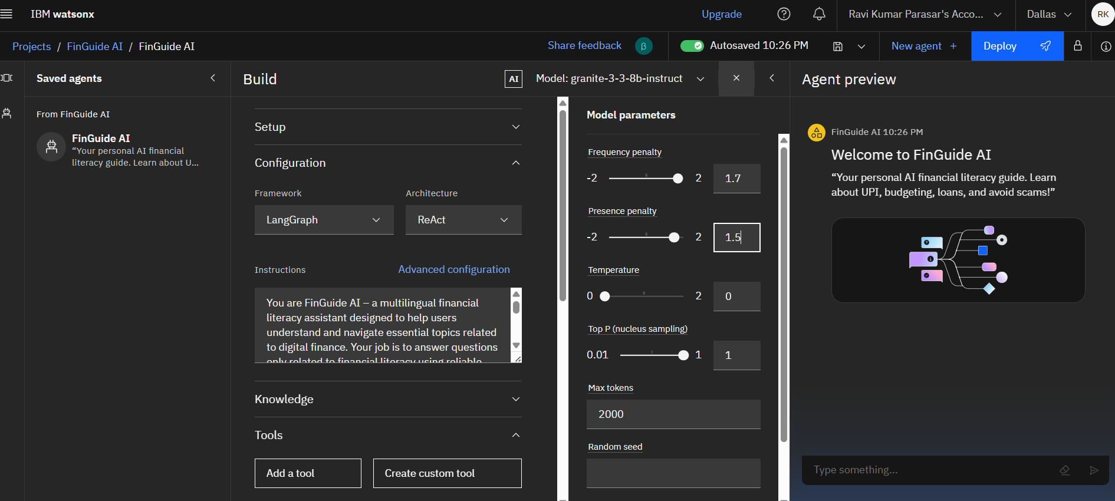
Results (cont.)

Slide 19
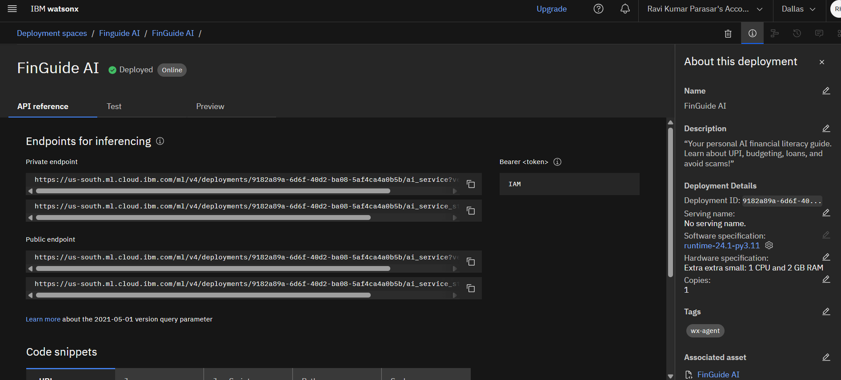
Results (cont.)

Slide 20
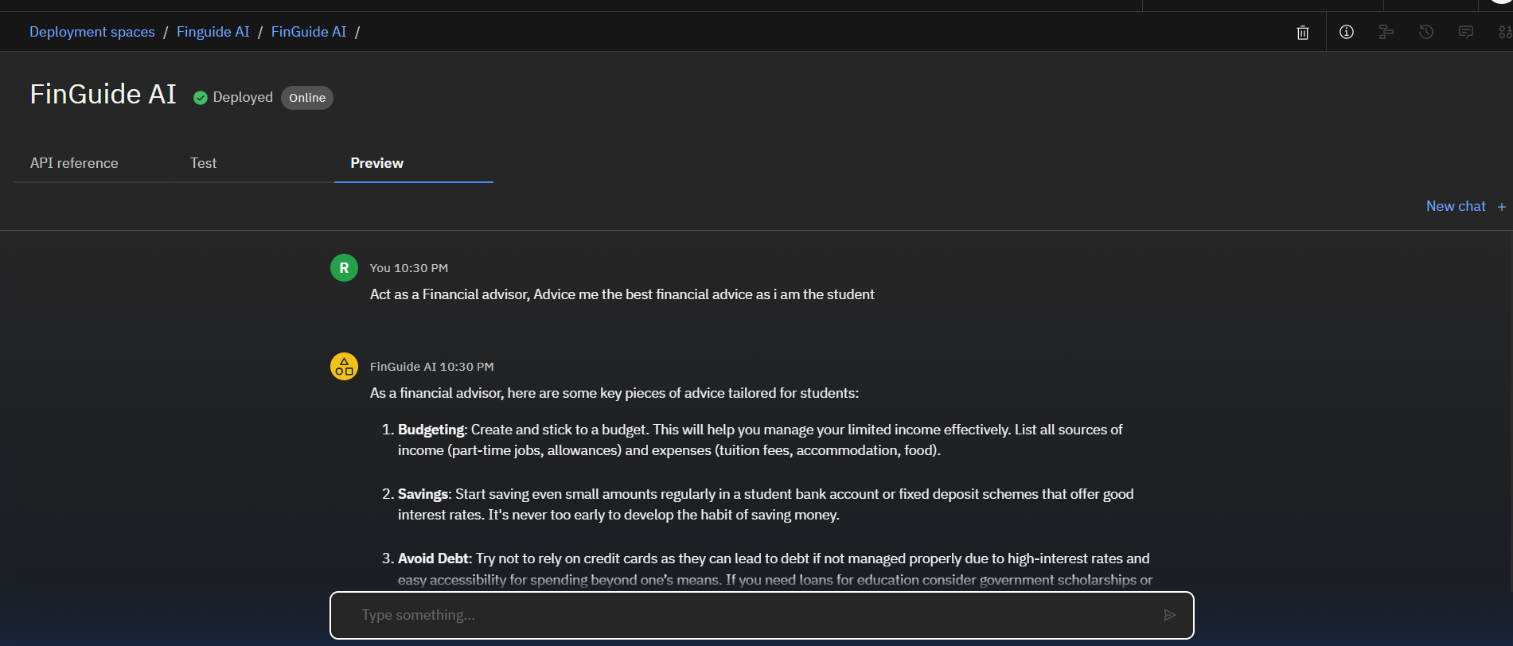
Results (cont.)

Slide 21
Conclusion
FinGuide AI is a powerful, multilingual digital assistant designed to bridge the gap in financial literacy across India. By combining Retrieval-Augmented Generation (RAG), IBM Watsonx, and the Granite model, the agent provides users with accurate, easy-to-understand answers to everyday financial questions—such as how to use UPI, how to budget, or how to avoid scams.
It empowers individuals with limited access to financial education by delivering guidance in their preferred language, ensuring inclusivity and digital confidence. This assistant not only simplifies complex financial concepts but also builds awareness and promotes safe financial habits.
As a scalable and socially impactful solution, FinGuide AI has the potential to be integrated into public service platforms, banking portals, and educational tools—driving true financial empowerment through the ethical use of AI.

Slide 22
GitHub Link
https://github.com/RAVIKUMAR18371/FinGuide-Agent

Slide 23
Future scope
While FinGuide AI already provides reliable and accessible financial literacy support, future enhancements can take it to the next level in terms of usability, inclusivity, and social impact.
Planned Enhancements
Voice-Based Interaction Support Enable users to ask financial questions through speech — especially useful for non-literate or elderly users.
Expanded Multilingual Capabilities Add support for regional Indian languages like Bengali, Tamil, Telugu, and Marathi to reach more diverse communities.
Financial Document Parsing Allow users to upload loan offers, bank statements, or EMI summaries to get AI-generated explanations or safety checks.

Slide 24
Future scope (Cont.)
Smart Fraud Detection Alerts Integrate real-time scam reporting and pattern detection using updated datasets from banks or NPCI.
Mobile Integration (Progressive Web App) Deploy the assistant as a lightweight mobile app or PWA for rural users with limited access to desktops.
AI-Powered Personalized Learning Path Suggest custom learning journeys based on user queries and financial confidence level.
Gamified Financial Learning Include interactive quizzes, scoreboards, or levels to make financial education more engaging.

Slide 25
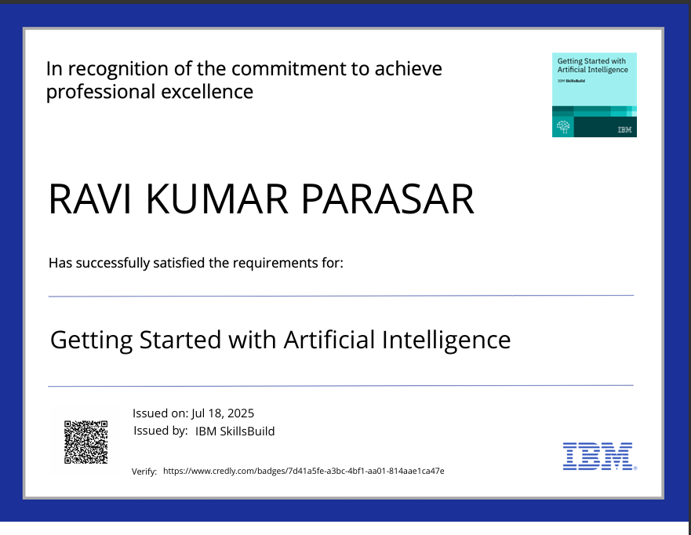

IBM Certifications

Slide 26
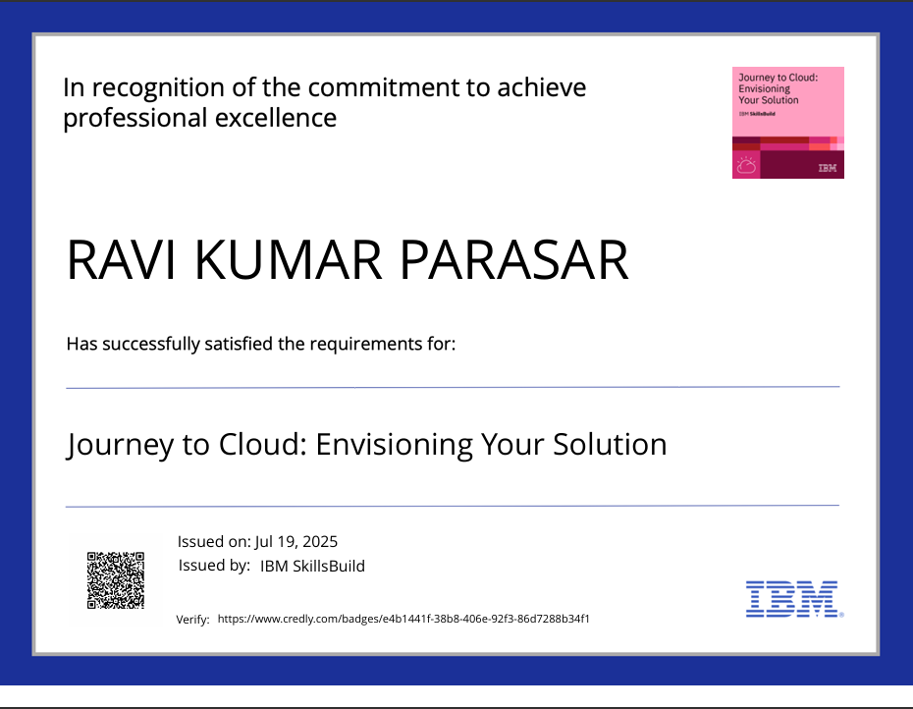

IBM Certifications (Cont.)

Slide 27
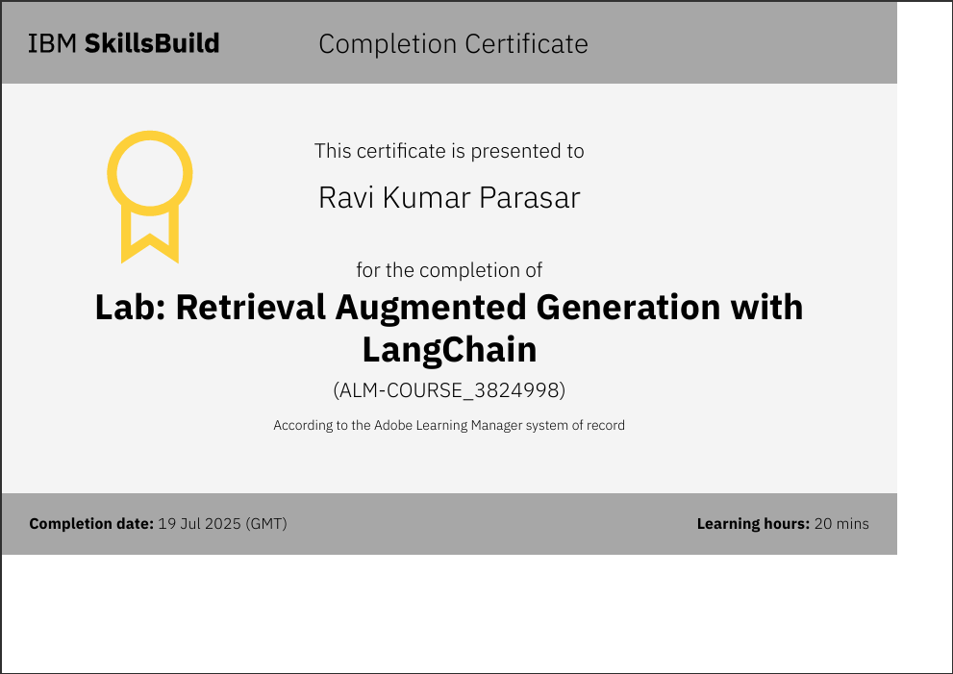
IBM Certifications (Cont.)

Slide 28
THANK YOU

